Slide 1
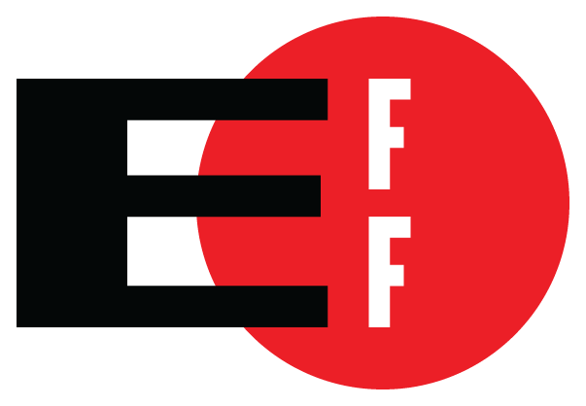


Reproducible Builds:
Moving Beyond Single Points of Failure for Software Distribution
Seth Schoen
Electronic Frontier Foundation
Mike Perry
The Tor Project
Hans-Christoph Steiner
Guardian Project

Slide 2
I want to believe
FOSS ethos: Users should have the source code to their programs
  For both individual freedom and software security
But: The only proof that binary packages correspond to the source code is that someone said so
  Without build system info, verification is almost impossible (and sometimes even with it)
This is inadequate for fostering trust in our software's functionality
We'll argue it's also inadequate in general

Slide 3
“But I'm the developer!”
“I know what's in the binary because I compiled it myself!”
“I'm an upstanding, careful, and responsible individual!”
“Why should I have to worry about hypothetical risks about the contents of my binaries?”

Slide 4
Unpleasant thoughts
We think of software development as a fundamentally benign activity. “I'm not that interesting.”
But attackers target a project's users through its developers
  See Dullien “Offensive work and addiction” (2014)
Known successful attacks against infrastructure used by Linux (2003), FreeBSD (2013)

Slide 5
Severity
We will try to convince you that this compromise is:
  extremely hard to detect
  extremely possible
  extremely harmful, if done maliciously

Slide 6

Imagine the most secure computer in the world...

Slide 7
Single Points of Failure
What if:
  Compromising that one computer gave access to:
    Hundreds of millions of other computers?
    Every bank account in the world?
    Every Windows computer in the world?
    Every Linux server in the world?
  Compromising that computer was worth:
    $100k USD? (Market price of remote 0day)
    $100M USD? (Censorship budget of Iran/yr)
    $4B USD? (Bitcoin market cap)

Slide 8
Single Points of Failure
Can that computer still remain secure if:
  It is networked?
  It is mobile or is physically accessible by others?
  It regularly has arbitrary USB devices connected?
  It must run Windows (in a VM)?
  It regularly runs unauthenticated HTML+JS?
  Several nation-states want access to it?

Slide 9
Bitcoin's motivation
Malicious modifications to Bitcoin binaries could result in irrevocable theft of large amounts of money
Individual developers could be blamed for such modifications; users might not believe that a developer's machine was hacked
Reproducible builds protect developers

Slide 10
How small can a backdoor be?
OpenSSH 3.0.2 (CVE-2002-0083) – exploitable security bug (privilege escalation: user can get root)
{
Channel *c;
- if (id < 0 || id > channels_alloc) {
+ if (id < 0 || id >= channels_alloc) {
log("channel_lookup: %d: bad id", id);
return NULL;
}

Slide 11
Result of fixing the bug (asm)
cmpl $0x0,0x8(%ebp)
js 16
mov 0x4,%eax
cmp %eax,0x8(%ebp)
jle 30
mov 0x8(%ebp),%eax
mov %eax,0x4(%esp)
movl $0x4c,(%esp)
call 25
cmpl $0x0,0x8(%ebp)
js 16
mov 0x4,%eax
cmp %eax,0x8(%ebp)
jl 30
mov 0x8(%ebp),%eax
mov %eax,0x4(%esp)
movl $0x4c,(%esp)
call 25

Slide 12
Resulting difference in the binary
What's the difference between if (a > b) and if (a >= b) in x86 assembly?
assembly: JLE → JL
opcode: 0x7E → 0x7C
binary: 01111110 → 01111100
A single bit!
Other corresponding opcode pairs also differ by just a single bit (JGE=0x7D, JG=0x7F)

Slide 13
Result of fixing the bug (asm)
cmpl $0x0,0x8(%ebp)
js 16
mov 0x4,%eax
cmp %eax,0x8(%ebp)
jle 30
mov 0x8(%ebp),%eax
mov %eax,0x4(%esp)
movl $0x4c,(%esp)
call 25
cmpl $0x0,0x8(%ebp)
js 16
mov 0x4,%eax
cmp %eax,0x8(%ebp)
jl 30
mov 0x8(%ebp),%eax
mov %eax,0x4(%esp)
movl $0x4c,(%esp)
call 25

Slide 14
Result of fixing the bug (hex)
55 89 e5 83 ec 28 83 7d 08 00 78 0a a1 04 00 00 00 39 45 08 7e 1a 8b 45 08 89 44 24 04 c7 04 24 4c 00 00 00 e8 fc ff ff ff b8 00 00 00 00 eb 35
Overall file size:
55 89 e5 83 ec 28 83 7d 08 00 78 0a a1 04 00 00 00 39 45 08 7c 1a 8b 45 08 89 44 24 04 c7 04 24 4c 00 00 00 e8 fc ff ff ff b8 00 00 00 00 eb 35
Approx. 500 kB

Slide 15
Result of fixing the bug (hex)
55 89 e5 83 ec 28 83 7d 08 00 78 0a a1 04 00 00 00 39 45 08 7e 1a 8b 45 08 89 44 24 04 c7 04 24 4c 00 00 00 e8 fc ff ff ff b8 00 00 00 00 eb 35
Overall file size:
55 89 e5 83 ec 28 83 7d 08 00 78 0a a1 04 00 00 00 39 45 08 7c 1a 8b 45 08 89 44 24 04 c7 04 24 4c 00 00 00 e8 fc ff ff ff b8 00 00 00 00 eb 35
Approx. 500 kB

Slide 16
Infected build platform
I created a Linux kernel module that alters attempts by the compiler (only the compiler) to read C source code
Source files as seen by the compiler get malicious code inserted before first line
For all other programs (cat, Emacs, sha1sum), source is totally unmodified
No files on disk are modified, including the kernel, compiler, and source files

Slide 17
Solution: Reproducible Builds
Ability to produce the same binary from source code on independent machines
Aka: Deterministic builds
Aka: Bit-identical builds
Aka: Idempotent builds
Notes:
This is where I see dead people

Slide 18
Reproducible build vision
Anyone in the world should be able to compile a program's source code and get a byte-for-byte identical binary
Confirming provenance of binaries
Infrastructure should be created to independently check popular binaries
  This is a benefit to those releasing the binaries: it provides external monitoring to find out if something bad happens to their infrastructure

Slide 19






Reproducible build reality
Only a handful of projects currently practice this
More are coming!
Notes:
Only a handful of projects currently practice this
* Bitcoin
* Tor Browser
* Guardian Project (Lil' Debi, CacheWord, IOCipher, etc)
But, more are coming!
* RedHat
* Debian
* F-Droid
* Mozilla

Slide 20
Bad chaos
Compile the same program twice on different computers → get different binaries (often!)
Compile the same program twice on the same computer → get different binaries (often!)
Why? Why isn't compilation a deterministic function?

Slide 21
Common obstacles
Different compilers or optimizations
Different header files
Different library versions
Build-environment metadata
Container formats with filesystem data
Timestamps
Signatures/key management
Test-driven optimizations (aka PGO)

Slide 22
Tor Browser overview
Firefox ESR-based “branch”
Third party tracking and fingerprinting patches
Tor client and Tor configuration Firefox addon
Pluggable Transports for traffic obfuscation
NoScript, HTTPS-Everywhere addons

Slide 23
Tor Browser build system
Uses Gitian (from Bitcoin)
Full package set signed by multiple builders
  Incremental updates too!
Supports anonymous independent verification
Does not require dedicated build hardware
Does not require non-free (as in beer) software
  MacOS and Windows are cross-compiled from Linux
  Linux tools are free as in freedom

Slide 24
Major toolchain components
Windows:
  MinGW-W64 (by commit hash)
  wine+py2exe
  nsis
Mac:
  Toolchain4 and Crosstools-ng forks by Ray Donnelly
  mkisofs and libdmg-hfsplus (patched)
Linux:
  GCC 4.9.1, binutils 2.24

Slide 25
Gitian overview
Developed by Bitcoin community
Wraps Ubuntu virt tools (Qemu-KVM and LXC)
Compilation stages are YAML "descriptors" that:
  Specify an Ubuntu release and arch
  Specify a package list
  Specify a list of git repos
  Specify additional "input" files
  Provide in-line bash script that creates "output" files
  Can be chained (with some glue code)

Slide 26
Issues Gitian solves
Normalizes build environment
  Hostname, username, build paths, tool versions, kernel/uname, time
Does not require dedicated build hardware
  Encourages community involvement in verification
Authenticates git-based inputs
Integrates with 'faketime' for spoofing timestamps

Slide 27
Gitian limitations
Ubuntu Only: Cross compilation is required
Needs non-git input authentication helpers
Needs dependency and descriptor management glue
No partial compilation state
  Base VM images are COW, and COW portion is destroyed
  faketime causes issues with dependency freshness checks
  Descriptor stages can be saved, but this gets error-prone
Time consuming
Kind of janky
  qemu-kvm process management issues
  Supports only one qemu-kvm or LXC slave at a time

Slide 28
Remaining reproducibility issues
Filesystem and archive reordering
  os.walk()/os.listdir()/readdir(), zip, tar
  LC_ALL and locale sorting order
Unitialized memory in toolchain/archivers
  binutils for mingw-w64, libdmg-hfsplus
  GNU linker: debug BuildID (32bit overflow for SHA1?)
Timezone and umask
Deliberately generated entropy (FIPS-140, sigs)
Authenticode and Gatekeeper signatures
LXC mode still often leaks:
  Kernel/uname, CPU (libgmp), hostname, memory???

Slide 29
Dependency authentication
Protect builders from discovery+targeted input attack
  Use Tor by default for fetching dependencies
  Authenticate all dependencies before use/compilation
Wrapper scripts for input fetching
  Verify signatures where possible
  Many things have weak/no signatures
    OpenSSL, GCC, faketime, OSX SDK, Go+python packages
    For these, use SHA256 based on multi-perspective download

Slide 30
This process is not always scary
Firefox and Tor Browser are massive and scary
Most software is not that complicated
Libraries tend to be simple
Android apps are mostly pure Java
Debian packaging provides a meta-process

Slide 31

Freezing time
Control time with libfaketime
Often works on simple builds
Some do not progress (ant)
Not all tools work with
LD_PRELOAD
Notes:
* freezing time with libfaketime
* faketime often works on native builds
* ant builds seem to rely on the clock ticking, they never complete with frozen time
* some Android tools do not work with LD_PRELOAD, like aapt

Slide 32
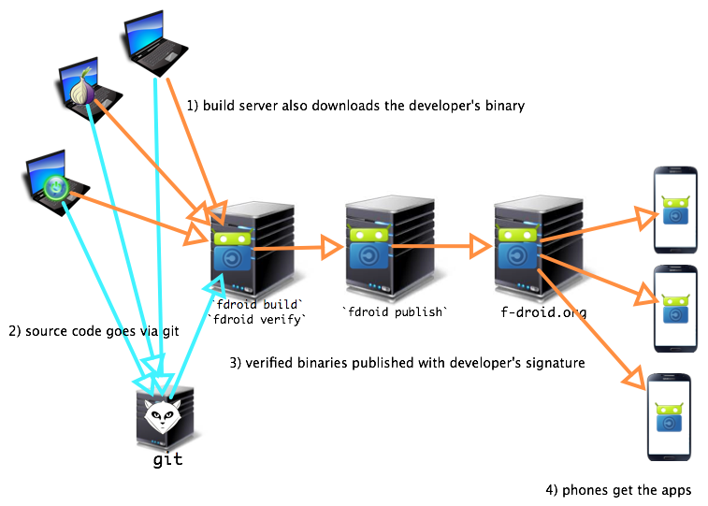
FDroid reproducible process
Notes:
* fdroid verify is a new process to codify reproducible builds in the distribution channel
* developer runs the build with fdroid, posts binary signed by official key
* f-droid.org runs the same build process, if the APK matches, uses the official signature from dev
* new process, lots of improvements are possible
* contributions are welcome!

Slide 33
A massive integration effort
Debian includes so many kinds of software
The effort has includes patches to: debhelper, cdbs, dpkg, python-setuptools, ghc, javadoc, epydoc, groff, octave, etc.
Debian's ReproducibleBuilds wiki is a gathering place for a huge array of problems and solutions

Slide 34

Debian strips out differences
packaging provides a meta-process
dh_stripdeterminism
strings normalized with padding
text file formats can be edited
integers altered in place
Notes:
Debian packaging provides a meta-process to tap into for making things reproducible
* The current Debian effort is based on stripping out the differences in the binary
* 32-bit int timestamps can be altered in place
* string timestamps can be normalized with padding

Slide 35
Problems with stripping
dh_stripdeterminism requires packages be built using debhelper (currently about 2/3 of them)
dh_stripdeterminism modifies the binary, it could be altered to slip in exploits
Trusting Trust issues: if all Debian packages are built with dh_stripdeterminism

Slide 36
Future work
Remove strict Ubuntu dependency for Gitian
  Ideally Debian and Ubuntu could be used to produce the same result
Trusting trust?
  Diverse Double Compilation for entire build environment
  Leverage cross compilation from multiple architectures, distributions
Multi-sig updates? Consensus updates?
  Tor Consensus can list update info
  Bitcoin blockchain
  Certificate Transparency log

Slide 37
More info
Reproducibility section of Tor Browser design document:
F-Droid verification process:
Debian Reproducible working group
  https://wiki.debian.org/ReproducibleBuilds

Slide 38
Thanks
Seth Schoen <schoen@eff.org>
FD9A 6AA2 8193 A9F0 3D4B F4AD C11B 36DC 9C7D D150
Mike Perry <mikeperry@torproject.org>
C963 C21D 6356 4E2B 10BB 335B 2984 6B3C 6836 86CC
Hans-Christoph Steiner <>
5E61 C878 0F86 295C E17D 8677 9F0F E587 374B BE81
Lunar <>

